Slide 1
TEAM 4 : LEADERSHIP-PERFORMANCE ANALYSIS OF NURSING HOME EMPLOYEES
NOVEMBER 16, 2019

Slide 2
Meet the Team
POOJA
PONMALAR
PRASHANTH
JAYAPRAKASH

Slide 3
AGENDA
Factor Analysis of Leadership and Performance
Research and Methodology
Key Takeaways
STEP 3
01
02
03
04
05
STEP 4
STEP 2
STEP 5
STEP 1
Review of survey instrument
Effect of Leadership on Performance of employees

Slide 4


Research and Methodology
Data is collected from employees of Nursing home to study the effects of Leadership on Performance of employees
Variables used – Demographic variables, Performance and Leadership
Methodology used – Survey

Slide 5
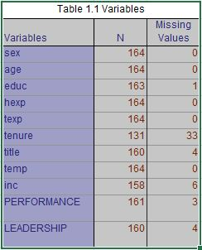
Review of Survey Instrument
Survey Variable labels appears reasonable however Tenure variable should be categorized which would in turn reduce the missing values.
Measures have been evaluated by doing reliability & validity tests and are found to be appropriate for our study.

Slide 6
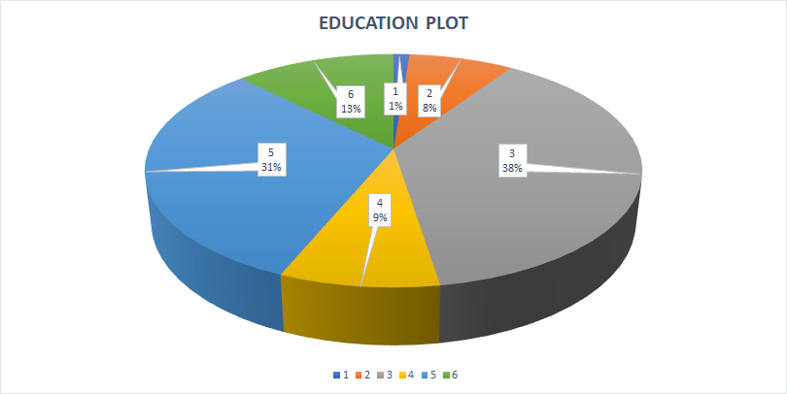
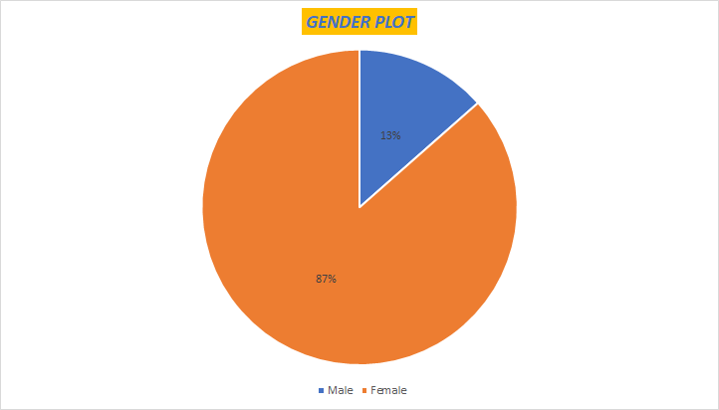
Review of Survey Instrument
Exploratory Analysis
Category-1: High School Category-4: Some College
Category-2: Technical Certification Category-5: College Degree
Category-3: Associated Degree Category-6: Graduate Degree

Slide 7
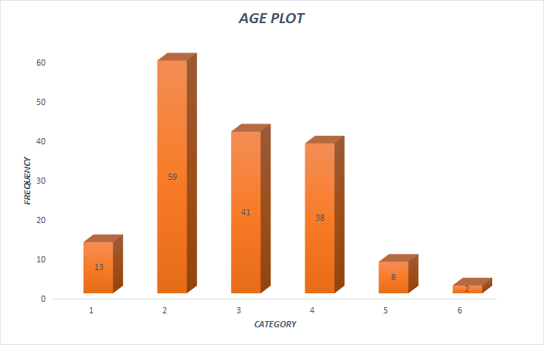
Review of Survey Instrument
Exploratory Analysis
Category-1: Age< 25 Years
Category-2: 25>Age<=35
Category-3: 35>Age<=45
Category-4: 45>Age<=55
Category-5: 55>Age<=65
Category-6: Age>65

Slide 8
Review of Survey Instrument
Interpreted Profile
Based on the demographic variables measured, we can safely conclude it increases the confidence in the data as we happen to found majority of the people who are working in this field.
AGE | EDUCATION | HEX | TEX | TENURE | TITLE | TEMP | INC | CODE | SEX
2 | 3 | 6 | 6 | 1 | 4 | 1 | 3 | 1 | Female

Slide 9
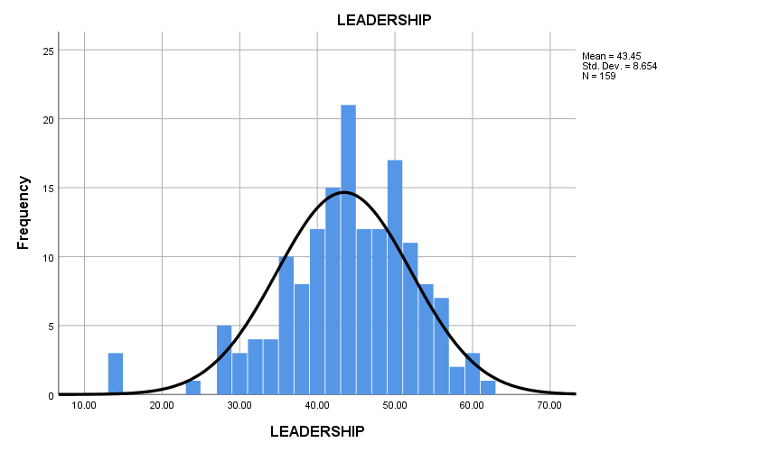
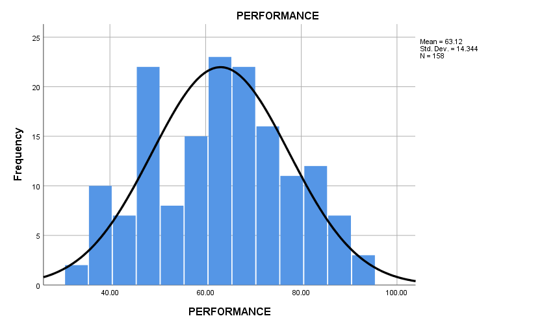
Factor Analysis of Leadership and Performance
Exploratory analysis and confirmatory factor analysis can be employed in a complementary fashion.
Data is suitable for Factor analysis because No outliers, Adequate Sample size, Interval data, Frequency distribution looks plausible, Extent of missing values is not high.
Notes:
PERFORMANCE: MEAN = 63.12, Standard Deviations = 14.344, N = 158
LEADERSHIP: MEAN = 43.45, Standard Deviations = 8.854, N = 159
Factor analysis provides information about reliability, item quality, and construct validity.
General goal is to understand whether and to what extent items from a scale may reflect an underlying hypothetical construct or constructs, known as factors.
An analytic method with high sensitivity to identify problematic items and assess the number of factors.
Patterns of high inter-item correlations among subsets of items suggest more than one factor because the items tend to “cluster” together Any number of factors might underlie a set of items, up to the total number of items (which would imply no common factor
A confirmatory factor analysis assumes that you enter the factor analysis with a firm idea about the number of factors you will encounter, and about which variables will most likely load onto each factor.
An exploratory factor analysis aims at exploring the relationships among the variables and does not have an a priori fixed number of factors. You may have a general idea about what you think you will find, but you have not yet settled on a specific hypothesis.
Exploratory factor analysis (EFA) could be described as orderly simplification of interrelated measures. EFA, traditionally, has been used to explore the possible underlying factor structure of a set of observed variables without imposing a preconceived structure on the outcome.
By performing EFA, the underlying factor structure is identified. Confirmatory factor analysis (CFA) is a statistical technique used to verify the factor structure of a set of observed variables.
CFA allows the researcher to test the hypothesis that a relationship between observed variables and their underlying latent constructs exists. The researcher uses knowledge of the theory, empirical research, or both, postulates the relationship pattern a priori and then tests the hypothesis statistically. The process of data analysis with EFA and CFA will be explained.
Examples with FACTOR and CALIS procedures will illustrate EFA and CFA statistical techniques. Introduction CFA and EFA are powerful statistical techniques. An example of CFA and EFA could occur with the development of measurement instruments, e.g. a satisfaction scale, attitudes toward health, customer service questionnaire. A blueprint is developed, questions written, a scale determined, the instrument pilot tested, data collected, and CFA completed. The blueprint identifies the factor structure or what we think it is. However, some questions may not measure what we thought they should. If the factor structure is not confirmed, EFA is the next step. EFA helps us determine what the factor structure looks like according to how participant responses. Exploratory factor analysis is essential to determine underlying constructs for a set of measured variables.

Slide 10
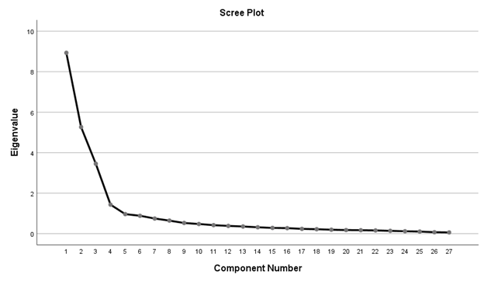
Factor Analysis of Leadership and Performance
Leadership and Performance have been analyzed simultaneously.
Scree plot makes it clear that four strong factors underlies Performance-Leadership analysis with two subdimensions each.

Slide 11
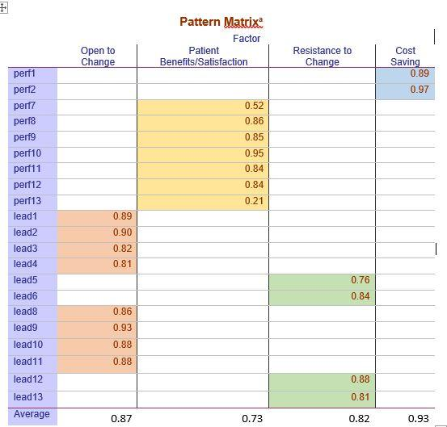

Our identified factors satisfies both convergent and discriminant validity
Table 2.1 Convergent validity
Average Variance Extracted by both factors of Leadership (0.87 and 0.82 ) , Performance (0.73 and 0.93) > Average variance shared between them 0.16, 0.27 respectively
Discriminant Validity is satisfied
Item loadings > 0.70 Convergent Validity is satisfied
Table 2.2 Discriminant validity
Notes:
what to explain in this?

Slide 12
Factor Analysis of Leadership and Performance
Leadership Factors Open to Change and Resistance to Change
Performance Factors Cost Saving and Patient Benefits/Satisfaction
Common leadership attributes
Open to change -> Welcoming new changes, Highly motivating and they make employees feel more enthusiastic about their work
Resistance to change -> Not open to new changes, Happy with existing system, stick to your guns
Common Performance attributes
Patients Benefits/Satisfaction-> Employees self evaluated their performance relative to their coworkers on achieving patient satisfaction, how their service benefits patients by providing quality medical service and building trust.
Cost Saving- -> cost saving and resource utilization aspects

Slide 13

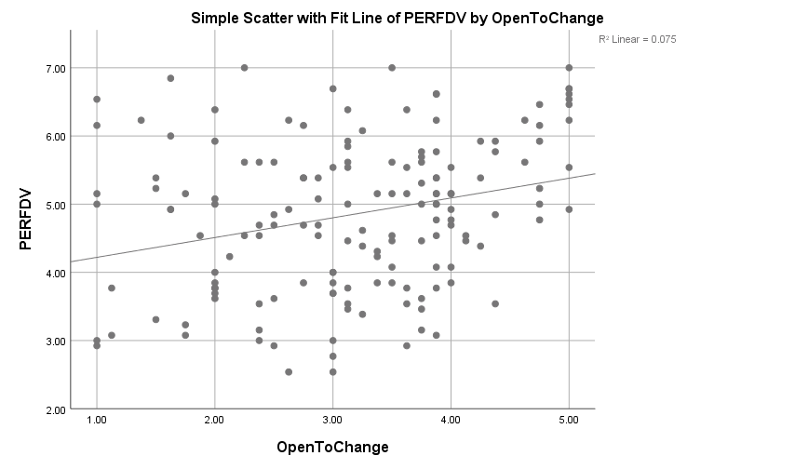
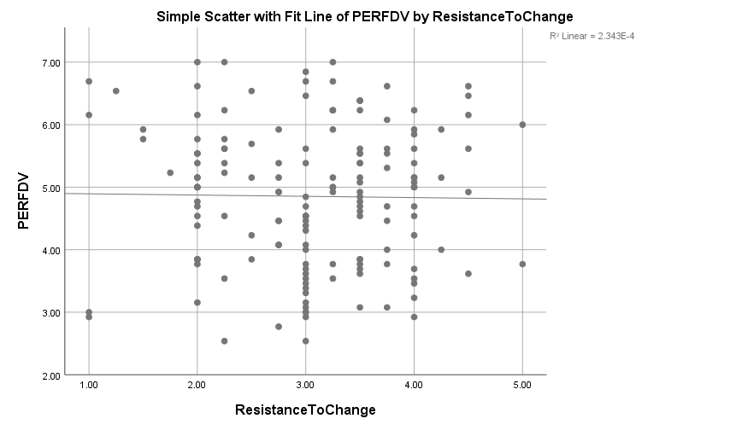
Effect of Leadership on Performance of employees
Leadership that is open to change and highly motivating is believed to improve performance of employees than the one that resists new changes.
‘Open to Change’ leadership statistically proven most significant
‘Resistance to change’ leadership statistically proven least/not significant.

Slide 14

Key Takeaways
Leadership that is open to changes and motivating makes a positive impact on performance of employees.
We can safely recommend the nursing home to consider adapting leadership that is open to change which would in turn motivates employees to perform better

Slide 15
Thankyou!
Questions?

